Slide 1
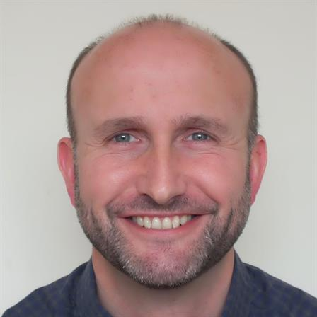
Welcome to DXD L4 DevOps Culture and Methodologies
7 - 9 December 2020
09:30 - 16:30
Andrew Burgess
Software Development and DevOps Tutor
andrew.burgess@qa.com
Notes:
Replace with trainer photo and details of name, job title and email
Intro slides should be covered in less than 30 mins, ideally 20 mins.
Add dates
Has start and end times but discuss break options

Slide 2
Troubleshooting
If I Disconnect
One of you will automatically become the host and when I return, I’ll resume the course
Please don’t leave the session
If you Disconnect
Don’t Panic
Re-join using your link
Contact
virtual.learningteam@qa.com
Chat link from your joining email
0203 908 2376

Slide 3
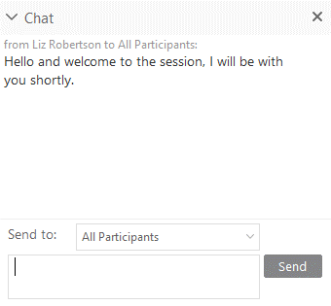
CHAT WINDOW
Ask & Answer Questions
Add Comments
Chat with everyone
Notes:
This is relevant for WebEx Training, will be different for attendees using Teams.
Trainer: Ask everyone to change “Send To” to All Participants and use this setting throughout the course
Benefits: Everyone then sees questions, answers & comments from everyone and feels more connected
If participants can’t see “All Participants”, check it is ticked in Participants Menu / Assign Privileges
When in screenshare, Chat window will be available from the toolbar at the top centre of the screen

Slide 4
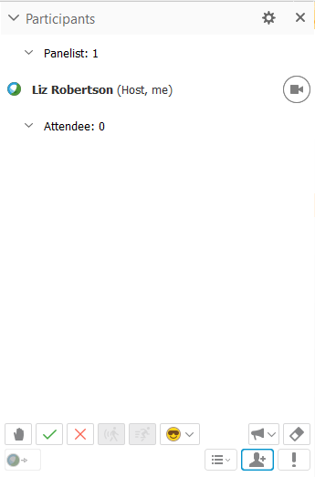

EMOJIS
How are you feeling?
Need a coffee?
Finding a topic interesting?
Yes / No
Notes:
This is only relevant for WebEx Training.
Session Options / Feedback must be ticked to display panel
Use regularly to confirm understanding of a topic / ask a quick question / Coffee Cup when away etc..
When in screenshare, Participants window will be available from the toolbar at the top centre of the screen

Slide 5

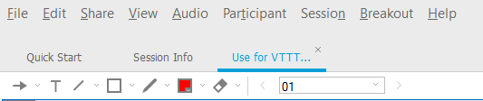
Annotation Tools
Notes:
This is only relevant for WebEx Training.
Are they switched off? Participants Panel / Assign Privileges / Annotate must be ticked
When in screenshare you must give them rights to annotate – on your Annotation Panel “All Attendees” must be ticked

Slide 6

Use the annotation tools to show where you are...

Slide 7
Questions?
Just Ask
Please interrupt me!

Slide 8
General timings
09:30 start
16:30 end
12:30 - 13:30 lunch
10 minute break about every hour
Notes:
Enter topics / modules from course outlines / objectives

Slide 9
Monday
Introduction
DevOps as a culture
Continuous integration
Continuous delivery / deployment
Labs...
Agile planning
Designing a CI pipeline
CD in the real world
Other technologies
Notes:
Enter topics / modules from course outlines / objectives

Slide 10
Tuesday
Introduction to source control
Git basics
Git branching
Git forking
Pull requests
Labs...
Practical Git
Notes:
Enter topics / modules from course outlines / objectives

Slide 11
Wednesday
Installing Jenkins
Jenkins jobs
Labs...
Practical Jenkins
Notes:
Enter topics / modules from course outlines / objectives

Slide 12
Course materials
Learner Guide (PDF)
Slides (as PDF)
Lab instructions (PDF)
File transfer of zip file coming up...
Notes:
OPTIONAL
Separate info to be covered later on accessing course materials: Mimeo / Skillpipe etc.

Slide 13
DEVELOPMENT ENVIRONMENT
Remote PCs are available for anyone who needs them [links TBC]
If using own PC...
IDE (e.g. Visual Studio Code)
Git installed
Everyone: GitHub account
Notes:
OPTIONAL
Separate info to be covered later on accessing course materials: Mimeo / Skillpipe etc.

Slide 14
Online Learning Survey
Could you let me know (via chat)...
Estimate % of online learning completed
How useful did you find it?

Slide 15
End of Module Reflection / Submission
What’s the key thing that you have learnt?
What’s the key thing that you will want to improve, or do differently?
Also, when you get back to your workplace, can you briefly tell us:
What will you stop doing as a direct result of this Discover/Practise activity, and when?
What will you start doing as a direct result of this Discover/Practise activity, and when?
What will you continue doing, going forward?
How do you know that you have been successful?

Slide 16
Apply and Prove Activity
See the "apply" activity in Bud
... produce a project that explains and expands on your role within the company, and that evidences research you have done on a DevOps pipeline at work
Your output will be added to your final portfolio, as evidence

Slide 17
Introductions
Notes:
Introductions from learners should be short and punchy.
If it’s a small group, verbal may work best.
For larger groups, use any of the following slides to get them sharing info and using the WebEx online tools.

Slide 18
About me...
Andrew Burgess
Software Developer / Tutor
Marconi Underwater Defence Systems | Lucas Aerospace | CODA Financials | bespoke software houses | packaged software houses | Carlsberg IT | web / advertising agencies | OutSystems (low-code)
Assembler | C | C++ | C# | some Java | Python | JavaScript
SQL Server | ASP.NET MVC | .NET Core | NodeJS | AngularJS | Angular
Docker | AWS | Azure | CI/CD pipelines

Slide 19
It’s all about YOU
Name
Where do you work?
Knowledge and Experience (programming, DevOps etc)
Notes:
OPTIONAL
Suitable for small groups. Verbal or chat window option for responses.

Slide 20
What are your Objectives for the event?
Daniel F
Daniel M
Dinesh
Mark
Notes:
Ask learners to pick a lane and use annotation tools to type in info. Trainer can then summarise.

Slide 21
Let’s Get Started…

